Slide 1
Title: AI-Driven Novel TL Approach for Efficient Classification of Brain Tumors using Deep CNNs
Author: Shumaila Majeed Supervisor: Dr. Nargis Bibi Institution: Fatima Jinnah Women University, Rawalpindi

Slide 2
Abstract
Role of Medical Imaging: Critical for cancer treatment, including diagnosis, treatment planning, and monitoring.
MRI for Brain Tumors: Widely used by radiologists; challenges include variability in tumor shape, location, and appearance.
Research Objective: Develop an automated algorithm using multimodal MRI scans to aid diagnosis and treatment.
Approach:
Combine deep learning CNNs with handcrafted features.
Models used: VGG16, VGG19, ResNet50, ResNet101 with SoftMax classifier.

Slide 3
Abstract
Proposed Technique:
Use SoftMax with pre-trained methods (ResNet, VGG).
Deep feature classification with Decision Trees, SVM-RBF, and SVM-linear.
Modified VGG19 combined with handcrafted properties.
Results:
Modified VGG19 achieved over 90% accuracy.
Reduced training time significantly.
Keywords: VGG19, Google Colab, Brain Tumor, Data Preprocessing.

Slide 4
Insights from the Data
BRATS2018
Data Set
• Tumor with 851 Scans
• Non-Tumor with 941 Scans

Slide 5
Data Preprocessing Steps
The techniques used for preprocessing
Grey Scale Conversion
• Resizing
• Pixel Conversion and Normalization
• Dimension Setting
• Labeling and One Hot Encoding
• Shuffling and Splitting

Slide 6
Algorithms used for Modeling
Resnet-50
Resnet-101
Vgg16
Vgg19

Slide 7
Problem Definition
Difficulty in diagnosing brain tumors due to variability in MRI scans.
Need for an efficient methodology using convolutional neural networks (CNNs).

Slide 8
Research Objectives
Develop automated techniques for classifying brain tumors.
Combine handcrafted and deep features to improve accuracy.
Test the proposed model using the BRATS 2018 dataset.

Slide 9
Methodology Overview
Approaches:
Transfer Learning with pre-trained models (VGG16, VGG19, ResNet50, ResNet101).
Customized VGG19 with feature fusion and Independent Component Analysis (ICA).
Dataset: BRATS 2018 dataset.

Slide 10
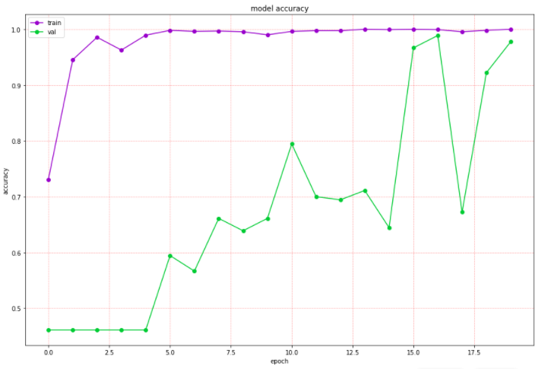
Resnet50
Model Accuracy | 97.78%
Polynomial kernel | 78.6%
RBF kernel | 79.5%
Reports the accuracy achieved using ResNet50, a well-known deep learning architecture, as a feature extractor with a SoftMax classifier

Slide 11
Resnet101
Model Accuracy | 62.78%
Polynomial kernel | 97.25%
RBF kernel | 89.94%
sigmoid kernel | 81.31%
Linear kernel | 86.01%
Presents accuracy metrics for ResNet101, which is deeper than ResNet50 but might show different performance trends depending on dataset complexity.

Slide 12
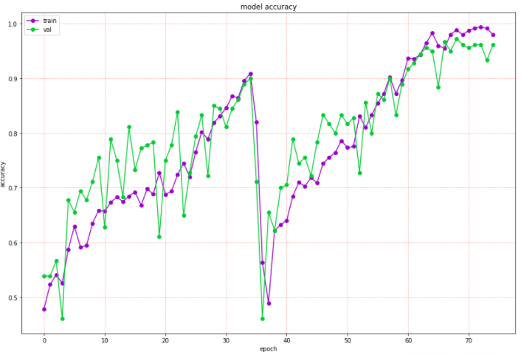
VGG19
Model Accuracy | 95.55%
Polynomial kernel | 83.16%
RBF kernel | 95.10%
sigmoid kernel | 94.05%
Linear kernel | 91.97%

Slide 13
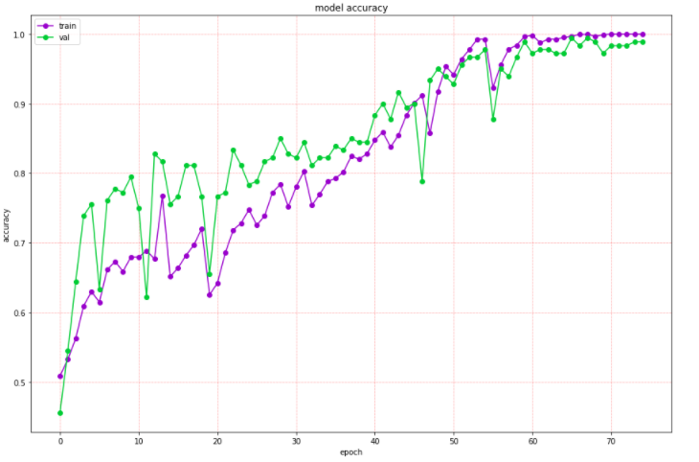
VGG-16 Model
Highlights the classification accuracy using VGG16, a simpler model compared to ResNet, showing its capability for this specific task.

Slide 14
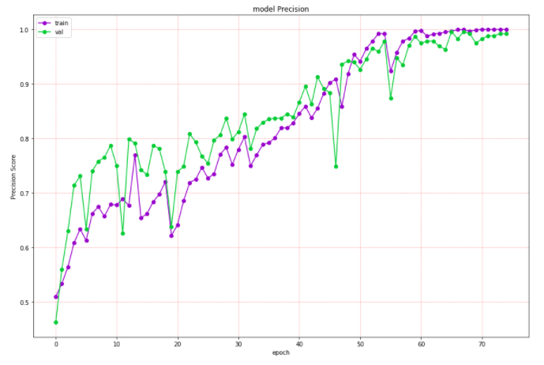
VGG-16 Model

Slide 15
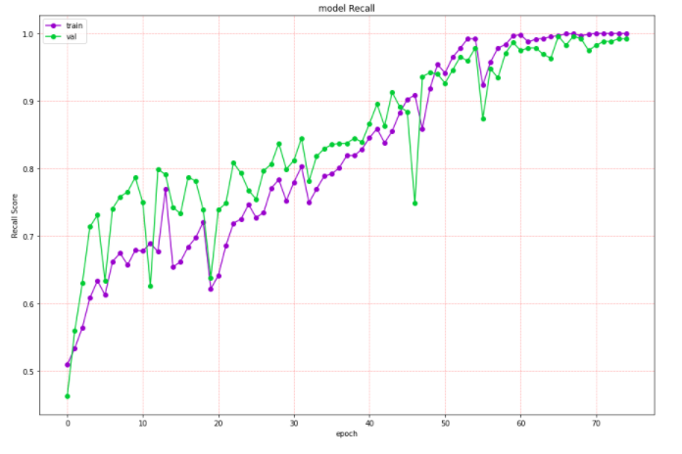
VGG-16 Model

Slide 16
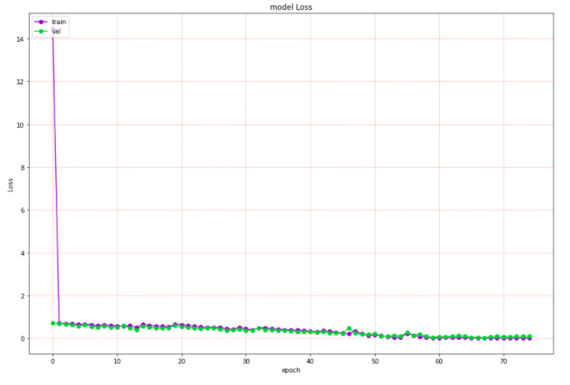
VGG-16 Model

Slide 17
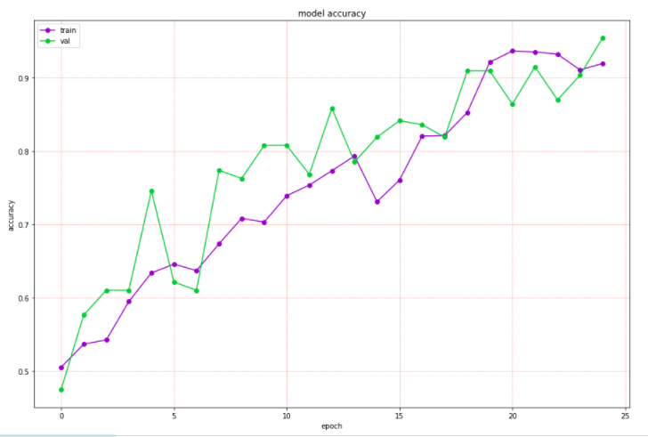
Customized VGG-19 Network
Shows the performance of the modified VGG19 architecture, emphasizing its ability to classify tumor and non-tumor MRI slices correctly.

Slide 18
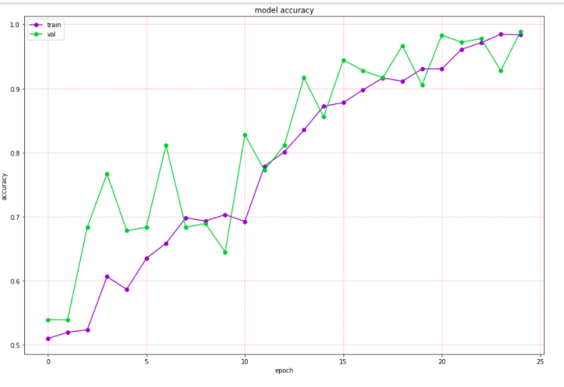
Customized VGG-19 Network
Highlights the balance between precision and recall, indicating the robustness of the modified model in handling imbalanced classes or false predictions.

Slide 19
Customized VGG-19 Network
Model Accuracy | 98.14%
Polynomial kernel | 80.40%
RBF kernel | 89.94%

Slide 20
Results
Modified VGG19 outperformed other models (ResNet50, ResNet101, VGG16).
Accuracy: 98.14%.
Reduction in training time and enhanced classification efficiency.

Slide 21
Contributions
Improved feature extraction using handcrafted and deep features.
Enhanced classification for glioma detection using modified VGG19.

Slide 22
Future Work
Extend methodology to segmentation tasks.
Improve feature fusion techniques.
Build robust models for low-grade and high-grade glioma classification

Slide 23
Conclusion
Automated classification methods can assist radiologists in early detection.
Modified VGG16 proves effective for brain tumor analysis using MRI.

